Slide 1
Project Title
HR DATA ANALYSIS
Name: MOHAMMED SALAH
Date: 10-03-2026

Slide 2
Business Context :
A mid-sized organization wants to improve its human resource planning, retention strategy, and departmental efficiency. The company has been collecting employee data over the years, including:
  Demographics
  Work history
  Performance
  Attrition details
Additionally, it maintains a department-level database with department names and IDs.
With rising attrition in some departments and concerns around performance consistency, the HR and Leadership teams want a data-driven understanding of employee trends — both current and historical — to guide decisions on:
  Hiring
  Promotions
  Organizational restructuring

Slide 3
Problem Statement :
To analyze employee demographics, performance, attrition trends, and departmental structures to deliver insights that:
Improve talent retention strategies
Identify performance bottlenecks
Support department-level workforce planning
Forecast potential risks such as high attrition or skill gaps

Slide 4
Stakeholders for this project :
HR and Leadership team
They would use it to:
Improve retention strategies
Monitor attrition
Plan hiring
Identify performance issues
Design training programs

Slide 5
Technology Stack :
Use of Excel, Sql and Power BI in this project:
Excel is used to do Exploratory Data Analysis. We check what data is available and what are the errors that needs to be cleaned before proceeding with the data.
We will make Pivot Tables and create different summaries from this data.
Sql is used to create more useful summaries on this data.
We use Sql to join both the tables used in this project to get a single table with all the data.
We use Power BI to create a model from the 2 tables.
We create DAX in Power BI. We create various Visualizations and KPI’s in Power BI.
We also create interactive filtering, using slicers etc.
Ultimately, we create an interactive Dashboard with Visualizations, KPI’s and Slicers which gives us understanding and insights of the data and enables us to make decisions.

Slide 6
Data Dictionary :
Emp_Info Table
Dept_Info Table
Columns | Description
Emp_Id | Employee_id
DOB | Date of Birth
First_name | First name of employee
Last_name | Last name of employee
Gender | Gender of employee, male or female
DoJ | Date of Joining/ Hiring
Projects | Number of projects worked on
Last_performance_rating | Last year performance ratin--> A, B, C, PIP & S
Left | Employee left the organization or not? i.e. 0 or 1
Last_date | Last date of employement(Exit Date)
Salary | Salary of employee
Dept_Id | Id of Dept in which employee works
Title | Designation of Employee
Performance issues | Employee has performance issue or not? i.e 0 or 1
Rating | S=5, A=4, B=3, C=2, PIP=1
Columns | Description
Dept_id | Department id
Dep_Name | Name of the department

Slide 7
Meta Data (1/3) :
Emp_Info Table:
There is no Primary Key in this table since some Emp_Id are repeated.
Dept_Id from this table references Dept_id from Dept_Info table.
This table shows the Employee Id, Date of birth as D-M-Y, First name and Last name of the employee, Gender as M or F.
When the employee joined the company, Date of joining as D-M-Y.
No of projects that the employee did last year, Last performance rating as S, A, B, C, PIP.
Did the employee leave the company as 0 (No), 1 (Yes).
If the employee left the company, it shows the last working day of the employee as D-M-Y.
Salary, Department Id of the employee, Job title of the employee and performance issues as 0 (No), 1 (Yes).
Employee has performance issue if He/She is earning above 80,000 and have a performance rating of C or PIP.
Rating from 1-5, which is S=5, A=4, B=3, C=2, PIP=1

Slide 8
Meta Data (2/3) :
Ratings Description:
Rating | Meaning | Description
A | Excellent / Outstanding | Top performer, exceeds expectations consistently. Often eligible for promotions, bonuses, leadership roles.
B | Good / Meets Expectations | Solid performer. Delivers what’s expected; may occasionally go beyond. Reliable and consistent.
C | Needs Improvement / Below Expectations | Underperforming slightly. May need coaching or upskilling. Not serious yet, but needs monitoring.
PIP | Performance Improvement Plan | Officially under review due to poor performance. Risk of termination if performance doesn't improve.
S | Star Performer / Strategic Contributor | Often used in some companies for elite talent. High-potential, future leader, or mission-critical employee.

Slide 9
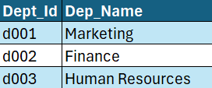
Meta Data (3/3) :
Dept_Info Table:
Dept_Id is the primary key.
Dept_Id from this table is referred by Dept_Id of Emp_Info table.
Department name is shown for each department Id.

Slide 10
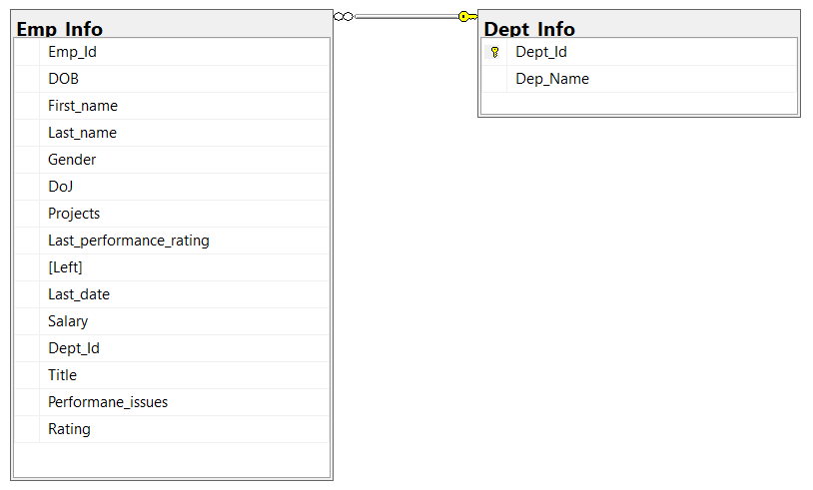
ER Diagram :
Dept_Info table has Dept_Id as Primary Key.
In Emp_Info table, Dept_Id is the Foreign Key which references Dept_Id from Dept_Info table.

Slide 11
Data Checks/Discrepancies :
Emp_Info Table:
The DOB, DoJ, Last_date columns have Date in the wrong format, these columns display Date in M-D-Y.
There are Employees who are in more than 1 Department.

Slide 12
STEPS PERFORMED FOR DATA PREPARATION :
Emp_Info Table:
We changed the Columns – DOB, DoJ, Last_date to D-M-Y Format using Text to Columns.
We added a new column called Performance_issues which displays 1 if an employee has salary above 80000 And their Last_performance_rating is “C” or “PIP” and displays 0 if not.
We added a new column which displays 1-5 based on Last_performance_rating column, where 5=S, 4=A, 3=B, 2=C, 1=PIP.

Slide 13
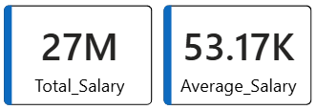
DETAILED ANALYSIS OUTPUTS :
KPI’s:
The total salary is 27 Million and the Average salary is 53.17 thousand.
Total employees is 500, with 456 still in the firm and 44 having left.
There are 306 male employees and 194 female employees.
There are 188 top performers (Employees with Performance rating of “S” or “A”)
There are 8 bad performers (Employees with Performance rating of “PIP” or “C” and salary above 80,000)

Slide 14
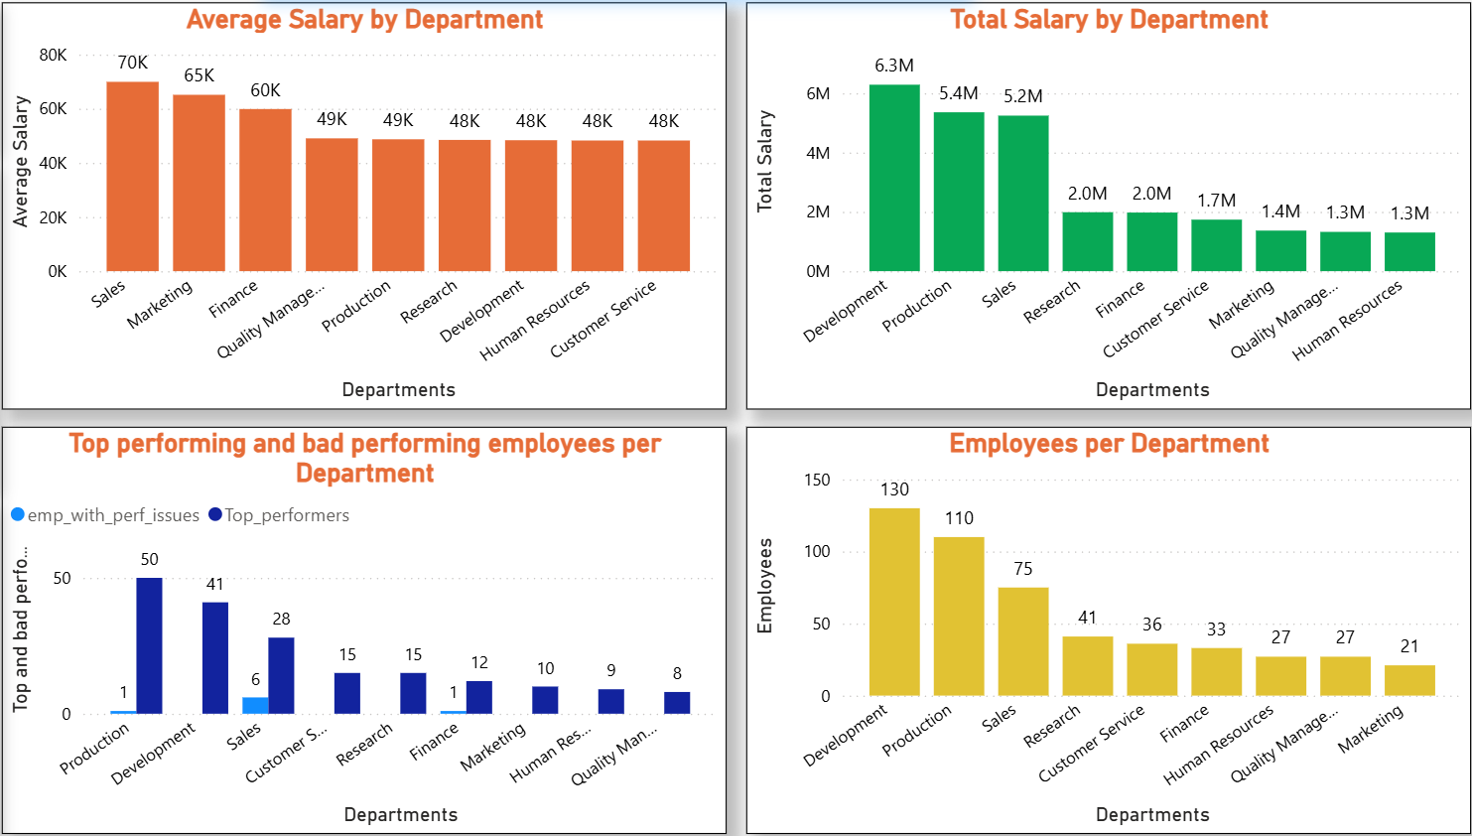
DETAILED ANALYSIS OUTPUTS :
Department Level:
Here we have the Total salary, average salary, count of employees and count of top and bad performers per department

Slide 15
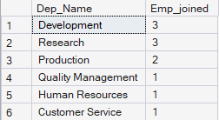
DETAILED ANALYSIS OUTPUTS :
Department Level:
Production has the highest top performing employees and Sales has the highest bad performing employees.
Sales has the highest average salary
Development has the highest total salary and employee count
From SQL queries we get to know that there are 51 employees who are there in 2 Departments.
These Departments saw the highest hiring in past 2 years.

Slide 16
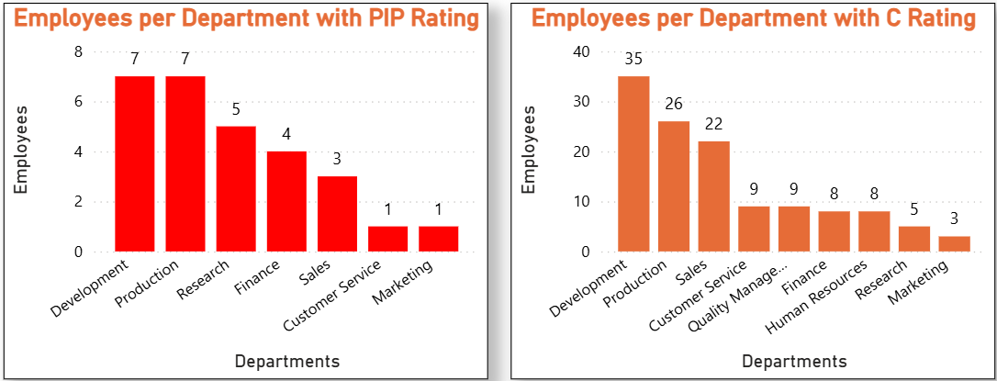
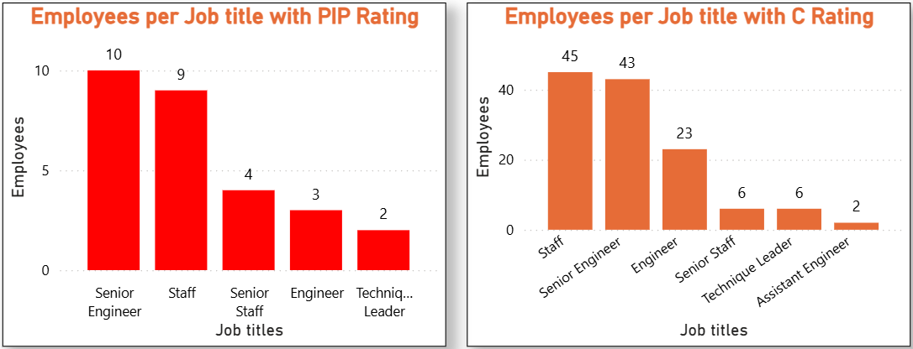
DETAILED ANALYSIS OUTPUTS :
Department Level:
These are the employees from each Department/Job title with “PIP” and “C” rating.

Slide 17
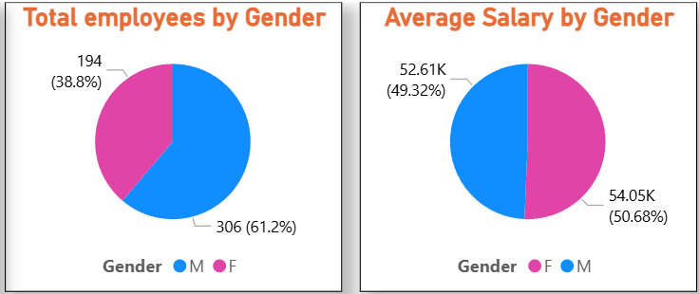
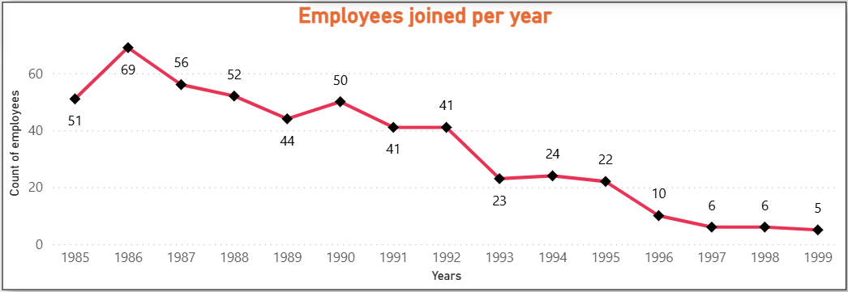
DETAILED ANALYSIS OUTPUTS :
Employee Level:
There are 306 male and 194 female employees.
The average salary of male employees is 52.61k and 54.05k of female employees.
The employees joining is slowly decreasing as the years pass.

Slide 18
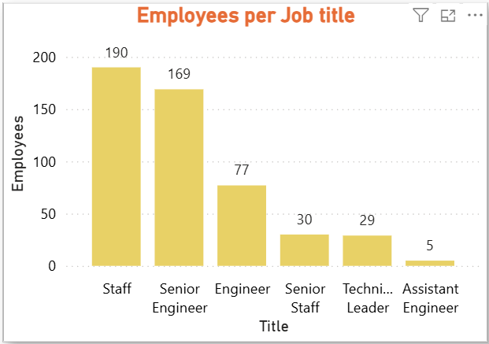
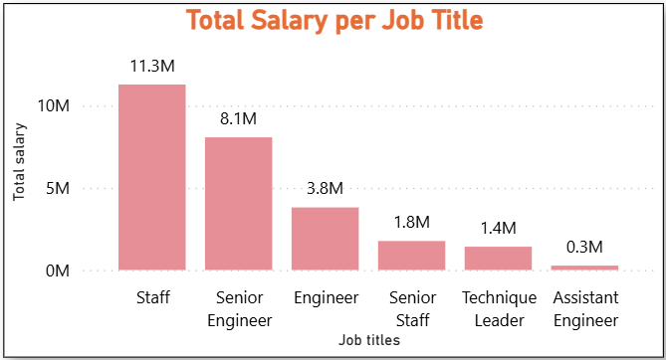
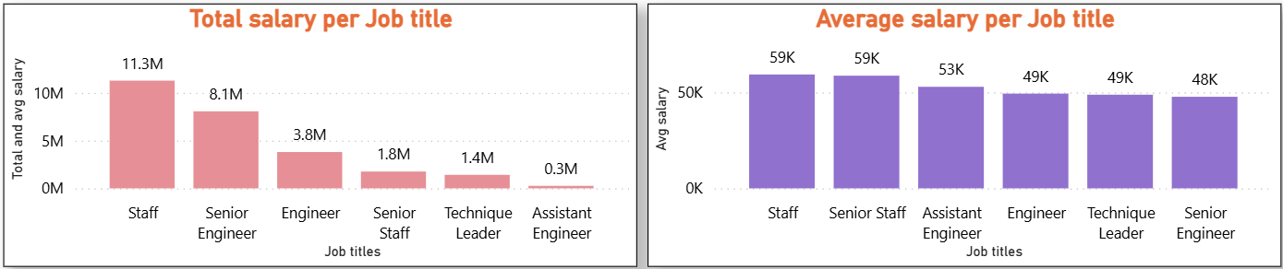
DETAILED ANALYSIS OUTPUTS :
Employee Level:
These are the number of employees in every job in the company.
Staff has the highest total and average salary since most employees are Staffs.
Assistant engineer have the lowest total salary since there are least no. of employees who are Assistant engineer.
Senior engineer have the lowest average salary.

Slide 19
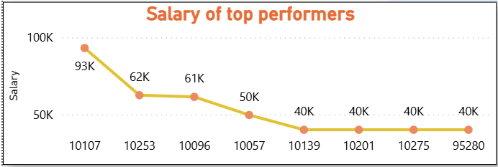
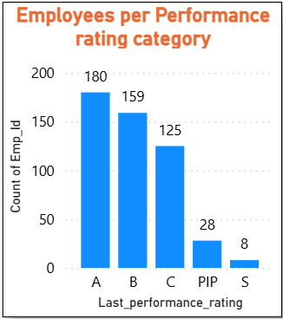
DETAILED ANALYSIS OUTPUTS :
Employee Level:
These are the salaries of the only 8 employees with “S/5” rating.
We can see max employees have Rating “A”, and least have rating “S”.
From SQL queries we get to know that there are 51 employees who are there in 2 Departments.
There are total 449 different employees in the company.
The average tenure of the employees who left is 7.39 Years.
Total no. employees in Leadership roles is 29.

Slide 20
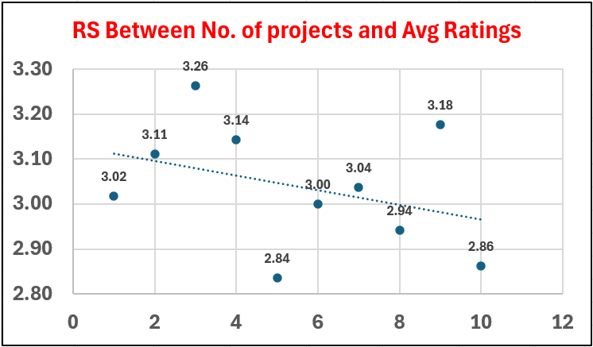
DETAILED ANALYSIS OUTPUTS :
Employee Level:
From this Scatterplot, it is clear that the Ratings of the employees do not increase with the increase in the no. of projects done by them. No. of projects and Ratings are not related to each other.

Slide 21
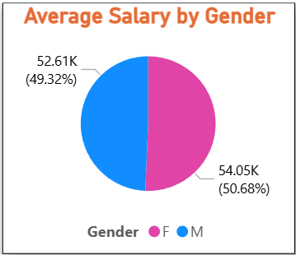
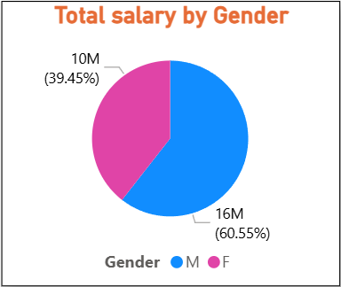
DETAILED ANALYSIS OUTPUTS :
Salary Level:
These are the salaries of the only 8 employees with “S/5” rating.
The average salary of male employees is 52.61k and 54.05k of female employees.
The total salary of male employees is 16m and 10m of female employees.

Slide 22
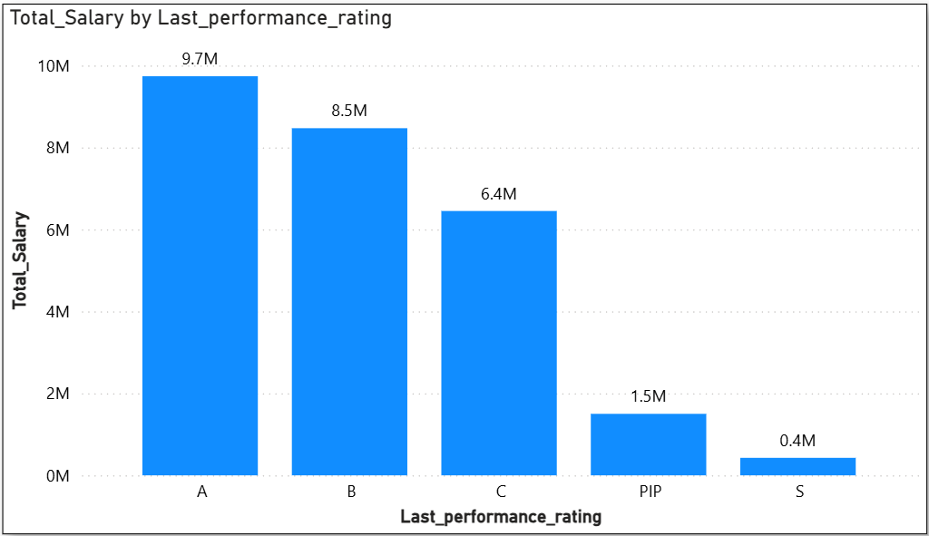
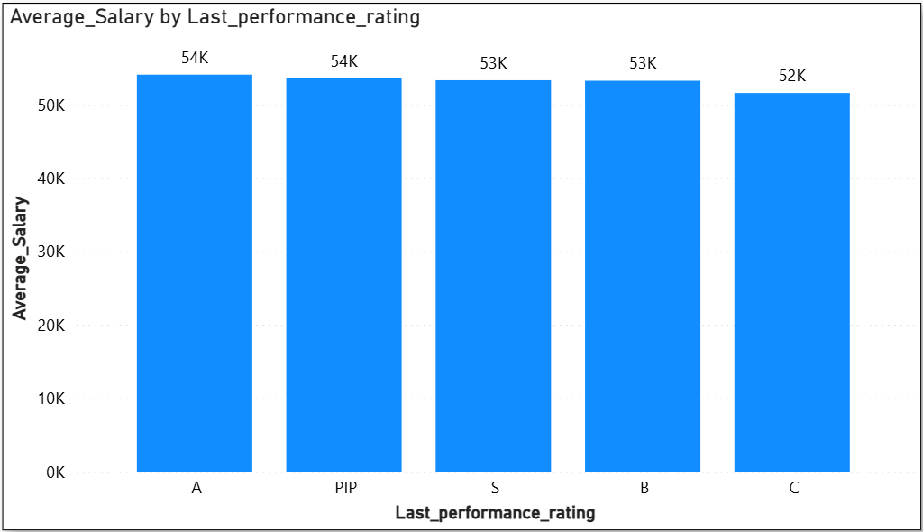
DETAILED ANALYSIS OUTPUTS :
Salary Level:
The total salary is highest of rating “A” since it has highest no. employees and lowest of rating “S” since it has lowest no. of employees.
The Average salary is highest of rating “A” and lowest of rating “C”.

Slide 23
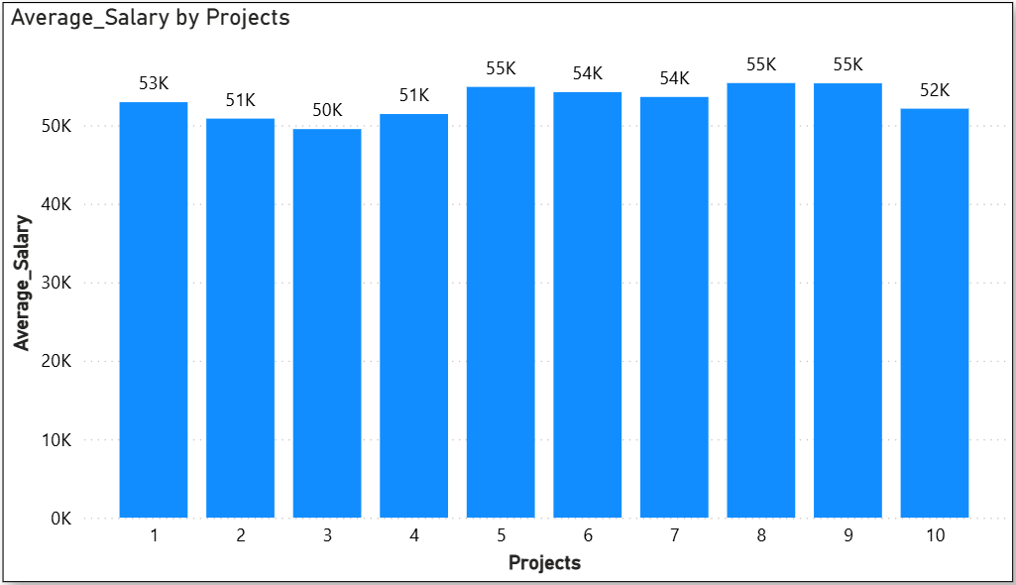
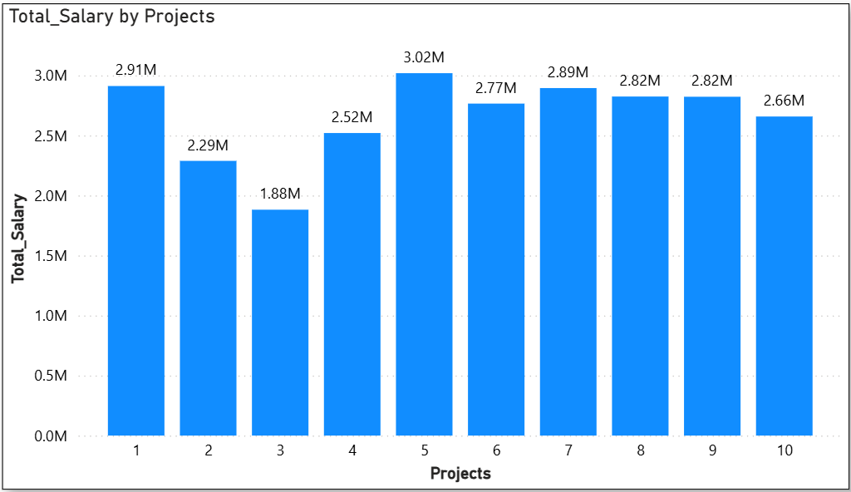
DETAILED ANALYSIS OUTPUTS :
Salary Level:
The Total and average salary are varying and the salary of an employee clearly doesn’t depend on their performance rating.

Slide 24
Recommendations :
The hiring is slowly declining over the years, so the company can increase it a bit by letting employees with performance issues go.
There are 28 employees with performance rating “PIP” who the company needs to deal with urgently.
There are 125 employees with performance rating “C” who the company needs to monitor and reduce the salary if it is high.
There are 8 employees who have performance rating of “PIP” or “C” and a salary above 80,000. The HR team needs to lower the salary of these employees.
There are 8 out of 500 employees who have a performance rating of “S”, but their salary is very low. 4 of them have a base salary of 40,000. Only 1 has above 80,000. The HR team needs to increase their salary to encourage them and to keep them in the company.
Out of 188 employees with “S” or “A” rating, 57 have a base salary of 40,000 and 131 have a salary less than 60,000. This should be looked after by the HR team.
There are 44 employees who left the firm, out of which 41 had a salary less than 66k. This was definitely a major reason they left and the company needs to look after it.

Slide 25
Recommendations :
The company needs to deal with the employees with “PIP/1” rating, reduce the salary of bad performers and increase the salary of top performers to make them stay.
The Development and Production departments and the Staff and Senior engineer job titles have the highest no. of employees and also the highest employees with “PIP” and “C” rating. The company needs to restructure these departments and job roles.

Slide 26
Challenges faced during the project :
Had difficulty in understanding what tool (Excel, Sql, Power BI) to use to prepare what summaries.
Had difficulty preparing summaries and deciding which summaries and insights to create.
Had difficulty in importing excel workbook in MySql environment, so I had to save the excel sheets as CSV files and import those CVS files in MySql.

Slide 27
THANK YOU!

